Slide 1


Machine Learning
Efi Arazi School of Computer Science
Introduction to Computer Science
Shimon Schocken
Lecture 13-1

Slide 2
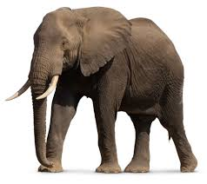
Detecting an elephant
After returning from a safari trip to Kenya, I captured many photographs and want to sort them based on the animals they feature.
How would you write a program that can identify whether an elephant appears in each image?

Slide 3
Detecting an elephant
How would you write a program that can identify whether an elephant appears in each image?
import java.awt.Color; /** A program that detects an elephant in a given picture */ public class ElephantDetector {
public static void main(String[] args) {
Color[][] pic = read(“safari-1.ppm”);
if (hasElephant(pic)) {
// Do something
}
}
private static Color[][] read(String fileName) { // From HW6; code is omitted
}
private static boolean hasElephant(Color[][] pic) {
// How would you write this code?
}
}

Slide 4
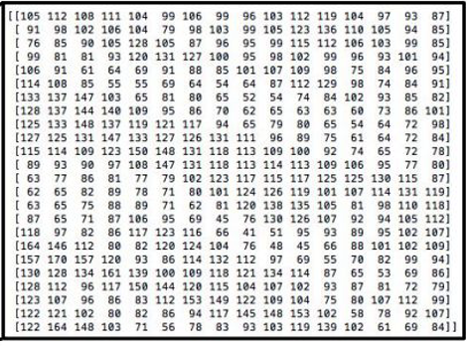
Detecting an elephant
How would you write a program that can identify whether an elephant appears in each image?
import java.awt.Color; /** A program that detects an elephant in a given picture */ public class ElephantDetector {
public static void main(String[] args) {
Color[][] pic = read(“safari-1.ppm”);
if (hasElephant(pic)) {
// Do something
}
}
private static Color[][] read(String fileName) { // From HW6; code is omitted
}
private static boolean hasElephant(Color[][] pic) {
// How would you write this code?
}
}
A picture is seen by the program as a two-dimensional array of numbers.
Challenge: How to design logic to detect an elephant in an image?

Slide 5


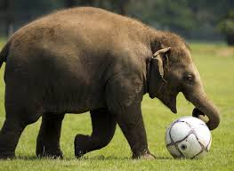


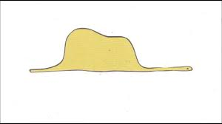
Detecting an elephant
An elephant can appear in a picture in countless ways, making the detection process quite complex.

Slide 6
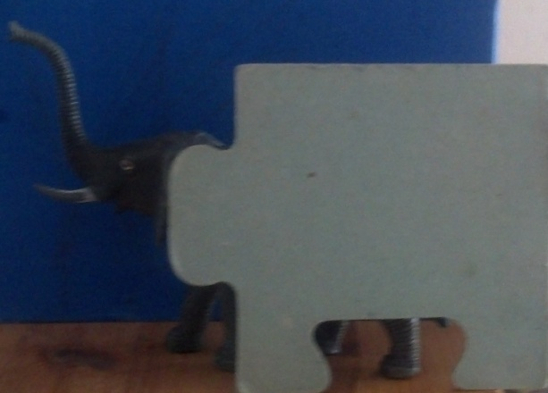
The complexity of detecting objects
For humans it's relatively easy, but for machines, it's quite difficult.

Slide 7

The complexity of detecting objects
How many chairs are in the picture?
For humans it's relatively easy, but for machines, it's quite difficult.

Slide 8
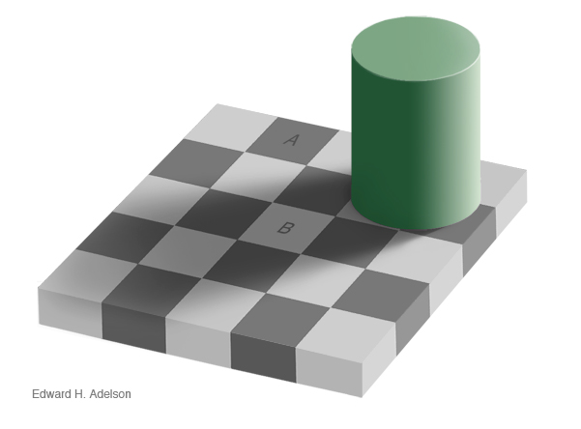
Some tasks are easier for machines than they are for humans
Boxes A and B have the same background color. True/False?

Slide 9
Some tasks are easier for machines than they are for humans
Boxes A and B have the same background color. True

Slide 10
Lecture plan
Introduction
Simple predictions
Gradient Descent
Predicting many features
Neural networks

Slide 11
Let’s take a simpler problem
You are a data analyst working for a big real-estate firm, and your task is to write a program that can predict the initial price of a given property.
Where should we start?

Slide 12
Price prediction
You can use the transaction dataset from last year, containing final prices for all properties.
property index | number of rooms | sq. meters | price
1 | 1 | 35 | 1,000,000
2 | 1 | 30 | 750,000
3 | 1 | 32 | 725,000
4 | 1.5 | 30 | 700,000
5 | 2 | 35 | 800,000
6 | 2 | 37 | 820,000
7 | 2 | 43 | 1,050,000
8 | 2.5 | 44 | 1,000,000
9 | 2.5 | 42 | 950,000
10 | 3 | 75 | 1,200,000
11 | 3 | 65 | 1,300,000
12 | 4 | 89 | 1,250,000
Dataset: a collection of data items (e.g., properties, pictures) provided along with their true target value (e.g., property price, elephant or not elephant). Typically stored in files or a database.

Slide 13
Price prediction
Every property is characterized by the number of rooms it has, and the size in sq. meters. Collectively, we define them as attributes or features.
property index | number of rooms | sq. meters | price
1 | 1 | 35 | 1,000,000
2 | 1 | 30 | 750,000
3 | 1 | 32 | 725,000
4 | 1.5 | 30 | 700,000
5 | 2 | 35 | 800,000
6 | 2 | 37 | 820,000
7 | 2 | 43 | 1,050,000
8 | 2.5 | 44 | 1,000,000
9 | 2.5 | 42 | 950,000
10 | 3 | 75 | 1,200,000
11 | 3 | 65 | 1,300,000
12 | 4 | 89 | 1,250,000
Your task is to predict the selling price of a new property based on its features.
public static double predict(double numOfRooms,
double size) {
// Your code
}

Slide 14
Price prediction
Every property is characterized by the number of rooms it has, and the size in sq. meters. Collectively, we define them as attributes or features.
property index | number of rooms | sq. meters | price
1 | 1 | 35 | 1,000,000
2 | 1 | 30 | 750,000
3 | 1 | 32 | 725,000
4 | 1.5 | 30 | 700,000
5 | 2 | 35 | 800,000
6 | 2 | 37 | 820,000
7 | 2 | 43 | 1,050,000
8 | 2.5 | 44 | 1,000,000
9 | 2.5 | 42 | 950,000
10 | 3 | 75 | 1,200,000
11 | 3 | 65 | 1,300,000
12 | 4 | 89 | 1,250,000
Your task is to predict the selling price of a new property based on its features.
public static double predict(double numOfRooms,
double size) {
// Your code
}
But how?

Slide 15
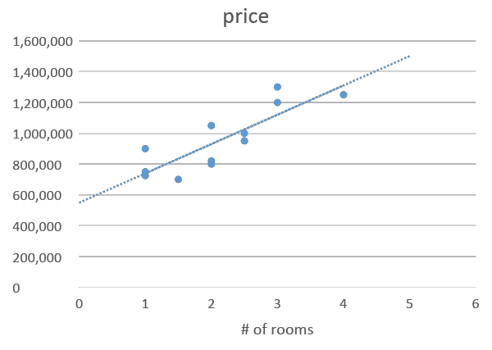
Visualization
Let’s focus on one feature for now: number of rooms. This will make it easier to visualize the dataset and identify any potential trends (מגמה).
property index | number of rooms | sq. meters | price
1 | 1 | 35 | 1,000,000
2 | 1 | 30 | 750,000
3 | 1 | 32 | 725,000
4 | 1.5 | 30 | 700,000
5 | 2 | 35 | 800,000
6 | 2 | 37 | 820,000
7 | 2 | 43 | 1,050,000
8 | 2.5 | 44 | 1,000,000
9 | 2.5 | 42 | 950,000
10 | 3 | 75 | 1,200,000
11 | 3 | 65 | 1,300,000
12 | 4 | 89 | 1,250,000

Slide 16
Visualization
Let’s focus on one feature for now: number of rooms. This will make it easier to visualize the dataset and identify any potential trends (מגמה).
Two observations:
There are properties with the same number of rooms sold for a different price.
Overall, we can see that the price grows linearly with the number-of-rooms feature.

Slide 17
Predicting the price of a new property
Two observations:
There are properties with the same number of rooms sold for a different price.
Overall, we can see that the price grows linearly with the number-of-rooms feature.
To predict the price of a new property, we can use the best-fitting trend
line to estimate its value.

Slide 18
Trending line
To do that, we need to write the equation representing the optimal trending line.
A general equation for a line:
y = ax + b
The slope
The intersection with the y axis

Slide 19
Trending line
y = ax+b
To do that, we need to write the equation representing the optimal trending line.
A general equation for a line:
y = ax + b
y = ax+b’ b’ < b

Slide 20
Trending line
y = ax+b
To do that, we need to write the equation representing the optimal trending line.
A general equation for a line:
y = ax + b
y = a’x+b a’ < a

Slide 21
Many potential trending lines
To do that, we need to write the equation representing the optimal trending line.
A general equation for a line:
y = ax + b
There are infinitely many possible lines, so how do we determine the best-fitting trend line?

Slide 22
Finding the best trending line
No line can be perfect, as every line will introduce some errors.
Therefore, we define the best trend line to be the line with the smallest error.
The error can be calculated for all the properties we have in the dataset. It is also known as the empirical risk or loss.

Slide 23
Finding the best trending line
No line can be perfect, as every line will introduce some errors.
Therefore, we define the best trend line to be the line with the smallest error.
The error can be calculated for all the properties we have in the dataset, also known as the empirical risk.
The red arrows represent the error predicting the price of each property using this trending line

Slide 24
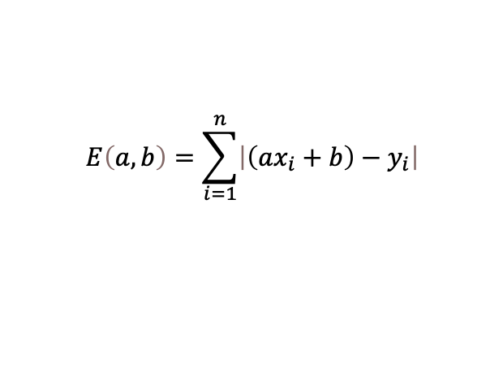
Finding the best trending line
No line can be perfect, as every line will introduce some errors.
Therefore, we define the best trend line to be the line with the smallest error.
The error can be calculated for all the properties we have in the dataset, also known as the empirical risk.
For each property i, xi is the number of rooms it contains, and yi is the price.
Therefore, the error of the line y = ax+b for property i is: |yi - axi+b|
Collectively, for all properties in the dataset, we define the error to be:
$$E\left(a,b\right)=\sum_{i=1}^{n}{\left|\left(ax_{i}+b\right)−y_{i}\right|}$$

Slide 25
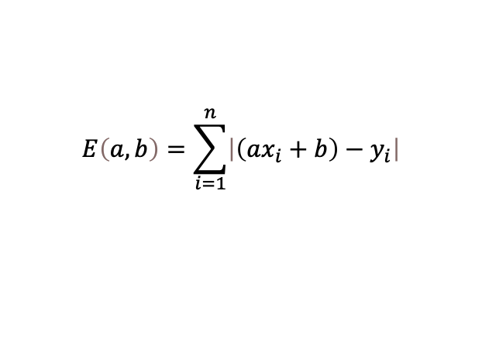
Finding the best trending line
Our updated task: find the values of a and b which minimize the error, defined as: The error is a function of a and b. Changing a and b will potentially result in a new error value.
$$E\left(a,b\right)=\sum_{i=1}^{n}{\left|\left(ax_{i}+b\right)−y_{i}\right|}$$

Slide 26
Machine learning
Instead of trying to solve problems directly, we write a program that learns how to solve the problem by looking at gold-standard (פתרון בית ספר) examples.
The procedure for learning is typically called train or fit and the outcome is typically referred to as model.
The procedure for using the model to predict the target is called predict or test.
Data items (Gold Standard) (e.g., examples of properties with prices)
Train
Model (e.g., a and b for a trending line)
Unseen data item (e.g., # of rooms)
Target (e.g., price)
Predict

Slide 27
Finding the best trend line
Our updated task: find the values of a and b which minimize the error, defined as: The error is a function of a and b. Changing a and b will potentially result in a new error value.
How would you approach this?
$$E\left(a,b\right)=\sum_{i=1}^{n}{\left|\left(ax_{i}+b\right)−y_{i}\right|}$$

Slide 28
Finding the best trend line
Our updated task: find the values of a and b which minimize the error, defined as: The error is a function of a and b. Changing a and b will potentially result in a new error value.
How would you approach this? Finding the minimum of E: we can take the derivative of E with respect to a and b and compare the derivatives to 0.
$$E\left(a,b\right)=\sum_{i=1}^{n}{\left|\left(ax_{i}+b\right)−y_{i}\right|}$$

Slide 29
Finding the best trend line
Our updated task: find the values of a and b which minimize the error, defined as: The error is a function of a and b. Changing a and b will potentially result in a new error value.
How would you approach this? Finding the minimum of E: we can take the derivative of E with respect to a and b and compare the derivatives to 0. Problem: absolute value is not differentiable.
$$E\left(a,b\right)=\sum_{i=1}^{n}{\left|\left(ax_{i}+b\right)−y_{i}\right|}$$

Slide 30
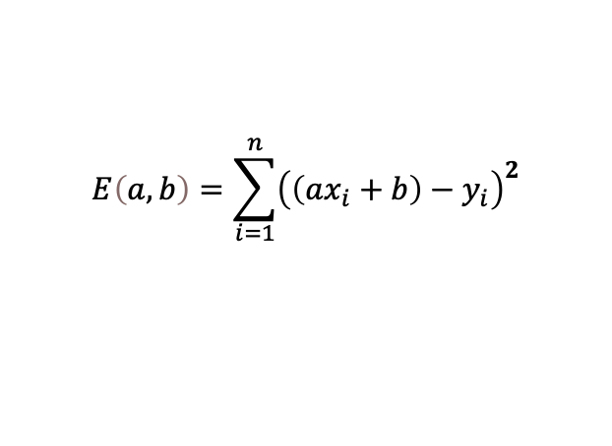
Finding the best trend line
Our updated task: find the values of a and b which minimize the error, defined as: The error is a function of a and b. Changing a and b will potentially result in a new error value.
How would you approach this? Finding the minimum of E: we can take the derivative of E with respect to a and b and compare the derivatives to 0. Problem: absolute value is not differentiable. Solution: change absolute to square:
$$E\left(a,b\right)=\sum_{i=1}^{n}{\left|\left(ax_{i}+b\right)−y_{i}\right|}$$
We don’t really care about the error itself, we only care about finding the best a and b.
$$E\left(a,b\right)=\sum_{i=1}^{n}{{\left(\left(ax_{i}+b\right)−y_{i}\right)}^{2}}$$

Slide 31
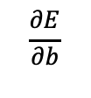
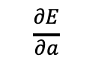
Deriving the error
$$\frac{∂E}{∂a}$$
$$\frac{∂E}{∂b}$$
We will have to take two partial derivatives: , and compare them to 0, and then solve for a and b.
Partial derivative (נגזרת חלקית) is when you take the derivative of a multivariate function with respect to only one of the variables

Slide 32
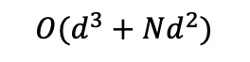
Deriving the error
$$\frac{∂E}{∂a}$$
$$\frac{∂E}{∂b}$$
We will have to take two partial derivatives: , and compare them to 0, and then solve for a and b. It’s doable but we are going to skip it for now, since the derivation algorithm is not very efficient:
$$O(d^{3}+Nd^{2})$$

Slide 33

Deriving the error
$$\frac{∂E}{∂a}$$
$$\frac{∂E}{∂b}$$
We will have to take two partial derivatives: , and compare them to 0, and then solve for a and b. It’s doable but we are going to skip it for now, since the derivation algorithm is not very efficient: - N is the number of data items in the dataset - d is the number of features
Luckly, there is an approximation algorithm to calculate a and b, which runs in linear time. It is called gradient descent.
$$O(d^{3}+Nd^{2})$$

Slide 34
Lecture plan
Introduction
Simple predictions
Gradient Descent
Predicting many features
Neural networks

Slide 35
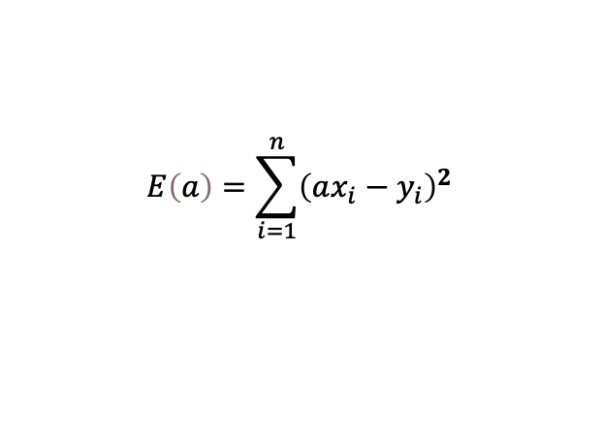
Gradient Descent (General Idea)
Let’s ignore b for now, we would like to find a that minimizes:
GD follows these steps:
$$E\left(a\right)=\sum_{i=1}^{n}{{\left(ax_{i}−y_{i}\right)}^{2}}$$
Initialize a with a random value
for t=1…T:
change a according to the update rule.

Slide 36
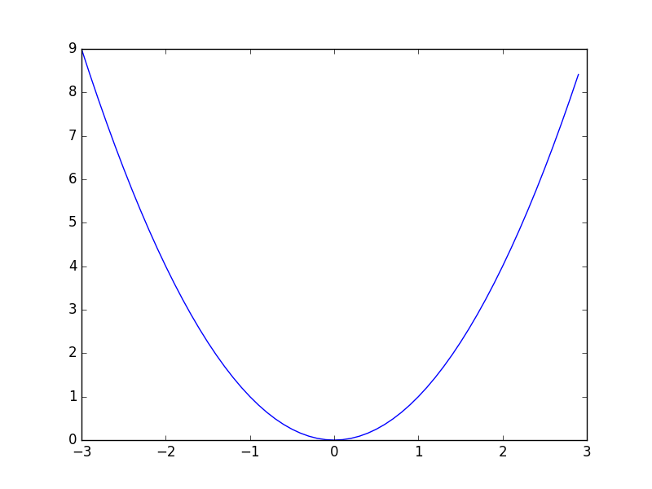


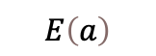
Gradient Descent – the update rule
Initialize a with a random value
for t=1…T:
change a according to the update rule.
$$E\left(a\right)=\sum_{i=1}^{n}{{\left(ax_{i}−y_{i}\right)}^{2}}$$
$$E\left(a\right)$$
Random value
$$a$$

Slide 37
Gradient Descent – the update rule
Initialize a with a random value
for t=1…T:
change a according to the update rule.
$$E\left(a\right)=\sum_{i=1}^{n}{{\left(ax_{i}−y_{i}\right)}^{2}}$$
$$E\left(a\right)$$
?
Random value
What should be the next value of a, to get a smaller error?
$$a$$

Slide 38
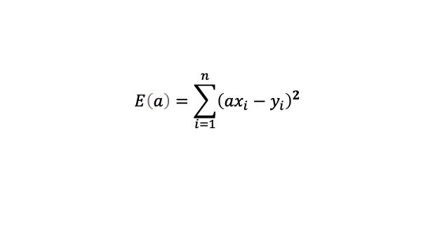
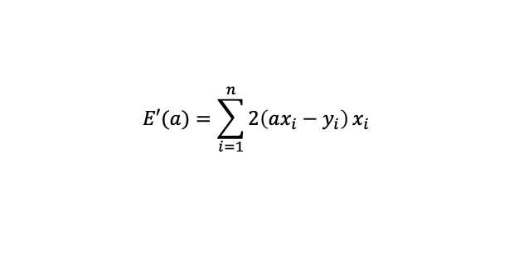
Gradient Descent – the update rule
Initialize a with a random value
for t=1…T:
change a according to the update rule.
$$E\left(a\right)=\sum_{i=1}^{n}{{\left(ax_{i}−y_{i}\right)}^{2}}$$
$$E\left(a\right)$$
$$E′(a)=\sum_{i=1}^{n}{2\left(ax_{i}−y_{i}\right)}x_{i}$$
E’(a=2) is the slop
of the tangent line (משיק)
at a=2
Observations:
If E’(a) is positive, then decreasing a is the right move, otherwise we should increase it.
As we get closer to the minimum of E, it is better to take smaller steps, otherwise we may pass it.
As we get closer to the minimum of E, E’(a) is getting smaller.
$$a$$

Slide 39

Gradient Descent – the update rule
Initialize a with a random value
for t=1…T:
change a according to the update rule.
$$E\left(a\right)=\sum_{i=1}^{n}{{\left(ax_{i}−y_{i}\right)}^{2}}$$
$$E\left(a\right)$$
$$E′(a)=\sum_{i=1}^{n}{2\left(ax_{i}−y_{i}\right)}x_{i}$$
E’(a=2) is the slop
of the tangent line (משיק)
at a=2
Observations:
If E’(a) is positive, then decreasing a is the right move, otherwise we should increase it.
As we get closer to the minimum of E, it is better to take smaller steps, otherwise we may pass it.
As we get closer to the minimum of E, E’(a) is getting smaller.
$$a$$
Then, let’s change a according to E’(a)
$$a=a − ηE′(a)$$

Slide 40
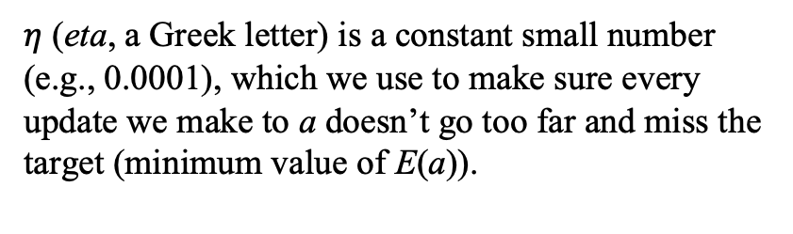

Gradient Descent – learning rate
Initialize a with a random value
for t=1…T:
change a according to the update rule.
$$a=a − ηE′(a)$$
$η$ (eta, a Greek letter) is a constant small number (e.g., 0.0001), which we use to make sure every update we make to a doesn’t go too far and miss the target (minimum value of E(a)).

Slide 41
Gradient Descent – train implementation
public double train(double[] x, double []y, int T, double learningRate) {
double a = Math.random();
for (int t = 0; t < T; t++) {
// Calculate the error
double e = error(x, y, a); // next slide
System.out.println(“Error at iteration “ + t + “ is “ + e);
// Update
double de = derivativeAt(x, y, a); // next slide
a -= learningRate * de;
}
}

Slide 42
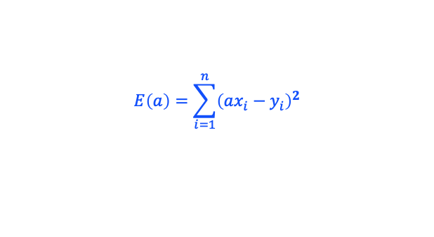
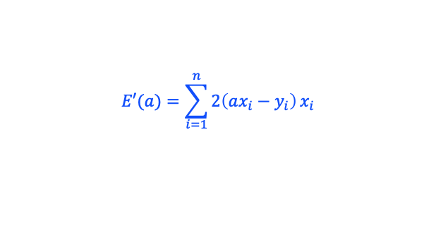
Gradient Descent – error and derivativeAt functions
private double error(double[] x, double []y, int a) { //
double e = 0;
for (int i = 0; i < x.length; i++) {
e += Math.pow(a * x[i] - y[i], 2);
}
return e;
}
private double derivativeAt(double[] x, double []y, int a) { //
double e = 0;
for (int i = 0; i < x.length; i++) {
e += 2 * (a * x[i] - y[i]) * x[i];
}
return e;
}
$$E\left(a\right)=\sum_{i=1}^{n}{{\left(ax_{i}−y_{i}\right)}^{2}}$$
$$E′(a)=\sum_{i=1}^{n}{2\left(ax_{i}−y_{i}\right)}x_{i}$$

Slide 43
Putting everything in a single class
public class LinearGradientDescent{
private double a;
public void train(double[] x, double []y, int T, double learningRate) {
a = Math.random();
for (int t = 0; t < T; t++) {
// Calculate the error
double e = error(x, y);
System.out.println(“Error in iteration “ + t + “ is “ + e);
// Update
double de = derivativeAt(x, y);
a -= learningRate * de;
}
}
// <error and derivativeAt functions> …
// predicting the price for an unseen property
public double predict(double x) {
return a * x;
}
}

Slide 44
Putting everything in a single object
LinearGradientDescent lgd = new LinearGradientDescent();
double[] x = {1, 1, 1, 1.5, 2, 2, 2, 2.5, 2.5, 3, 3, 4};
double[] y = {1000000, 750000, 725000, 700000, 800000, 820000,
1050000, 1000000, 950000, 1200000, 1300000, 1250000};
lgd.train(x, y, 10, 0.01);
System.out.println(lgd.a);
System.out.println(“The price of a property with 2.5 rooms is “ + lgd.predict(2.5));
public class LinearGradientDescent{
private double a;
public void train(double[] x, double []y, int T, double learningRate) {
a = Math.random();
for (int t = 0; t < T; t++) {
// Calculate the error
double e = error(x, y);
System.out.println(“Error at iteration “ + t + “ is “ + e);
// Update
double de = derivativeAt(x, y);
a -= learningRate * de;
}
}
// <error and derivativeAt functions>
// predicting the price for an unseen property
public double predict(double x) {
return a * x;
}
}
// Output
Error at iteration 0 is 1.1587996614548084E13
Error at iteration 1 is 1.6042276533501982E12
Error at iteration 2 is 8.492051256596089E11
Error at iteration 3 is 7.921065470030078E11
Error at iteration 4 is 7.877884669921023E11
Error at iteration 5 is 7.874619121912778E11
Error at iteration 6 is 7.874372164844656E11
Error at iteration 7 is 7.874353488716378E11
Error at iteration 8 is 7.874352076334176E11
Error at iteration 9 is 7.874351969522771E11
411606.82499137253
The price of a property with 2.5 rooms is 1029017.0624784313

Slide 45
Lecture plan
Introduction
Simple predictions
Gradient Descent
Predicting many features
Neural networks

Slide 46
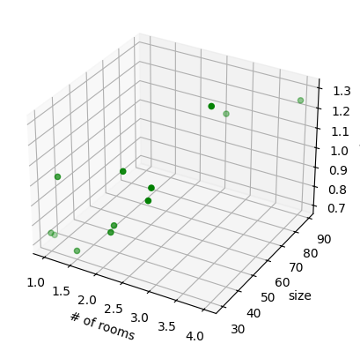
Predicting with many features
We can extend this algorithm to fit a model for items with multiple features. For instance, we can take the property-size (in sq. meter) feature into consideration. In this case, we fit a plane instead of a line.
property index | number of rooms | sq. meters | price
1 | 1 | 35 | 1,000,000
2 | 1 | 30 | 750,000
3 | 1 | 32 | 725,000
4 | 1.5 | 30 | 700,000
5 | 2 | 35 | 800,000
6 | 2 | 37 | 820,000
7 | 2 | 43 | 1,050,000
8 | 2.5 | 44 | 1,000,000
9 | 2.5 | 42 | 950,000
10 | 3 | 75 | 1,200,000
11 | 3 | 65 | 1,300,000
12 | 4 | 89 | 1,250,000

Slide 47
Predicting with many features
We can extend this algorithm to fit a model for items with multiple features. For instance, we can take the property-size (in sq. meter) feature into consideration. In this case, we fit a plane instead of a line.
Now we have two slopes, one for each axis. We can add more features like that.
y = ax1 + bx2 + c
property index | number of rooms | sq. meters | price
1 | 1 | 35 | 1,000,000
2 | 1 | 30 | 750,000
3 | 1 | 32 | 725,000
4 | 1.5 | 30 | 700,000
5 | 2 | 35 | 800,000
6 | 2 | 37 | 820,000
7 | 2 | 43 | 1,050,000
8 | 2.5 | 44 | 1,000,000
9 | 2.5 | 42 | 950,000
10 | 3 | 75 | 1,200,000
11 | 3 | 65 | 1,300,000
12 | 4 | 89 | 1,250,000

Slide 48
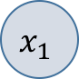
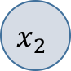
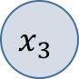
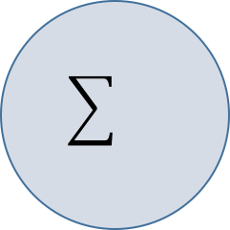
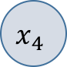
Artificial neuron
We may use more than two features.
Let’s visualize this equation as a graph:
Instead of a and b we use w1, w2, … and b
y = w1x1 + w2x2 +…+ b
w1
w2
w3
w4
y
wn
…
b
xd
We call all these numbers: weights

Slide 49
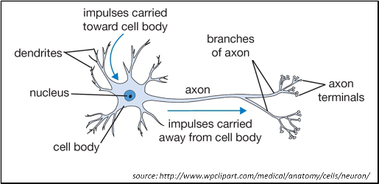
Artificial neuron
And this seems to be similar to a brain neuron.
y = w1x1 + w2x2 +…+ b
w1
w2
w3
w4
y
wn
…
xd
b

Slide 50
Lecture plan
Introduction
Simple predictions
Gradient Descent
Predicting many features
Neural networks

Slide 51
Neural network
And like with our brain neurons, we can combine neurons to handle more complicated tasks.
y1
…
One neuron is used to process the features of the input x.
xd

Slide 52
Neural network
And like with our brain neurons, we can combine neurons to handle more complicated tasks.
y1
y2
…
Adding another neuron, initialized (random guess) differently.
xn

Slide 53
Neural network
And like with our brain neurons, we can combine neurons to handle more complicated tasks.
y1
y2
y3
…
We can add another neuron (in fact as many neurons as we like).
Each neuron may have a different perspective on the data, since when we stop training, each will potentially stop at a different empirical risk value.
xn

Slide 54
Neural network
And like with our brain neurons, we can combine neurons to handle more complicated tasks.
y
…
But now that we have three outputs, we need to combine them somehow. We do that with another neuron.
Advanced: before pushing the values to the new neuron, we need to use some non-linear function.
xn

Slide 55
Feed-forward network
This is a two-layer neural network. This architecture is typically referred to as feed-forward network. There are many other architectures. ChatGPT, for instance, is a neural network based on the Transformer architecture, which was invented and published in 2017.
y
…
xn
1st layer
2nd layer

Slide 56
Back-propagation
To train a neural network we need to use an extended version of gradient descent, since we need to propagate the error from the 2nd layer to the 1st layer.
Back-prop is not covered in our course; it will be covered in some other courses, stay tuned.
y
…
xn

Slide 57
Feed-forward network for classification
A feed-forward network can be used for classification, and not just for predicting a value (regression). One way to do that is to consider the output with the largest value as the predicted class.
Let’s see an example in the next slide.
y1
y2
y3
…
xn

Slide 58
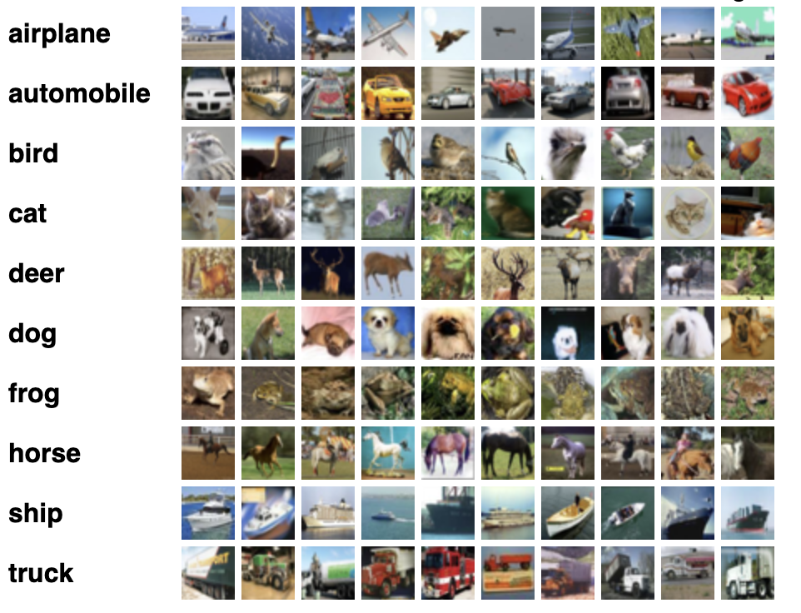
Feed-forward network for classification
For example, the CIFAR-10 dataset consists of 60000 32x32 color images in 10 classes (objects), with 6000 images per class. There are 50000 training images and 10000 test images. The task is to detect the object in the image.

Slide 59
Feed-forward (FF) network for classification
For example, the CIFAR-10 dataset consists of 60000 32x32 color images in 10 classes (objects), with 6000 images per class. There are 50000 training images and 10000 test images. The task is to detect the object in the image. We can build and train a FF network with 1024 inputs (32x32 pixels) and 10 outputs (one for each class).
y1
y2
y3
…
…
x1024
y10

Slide 60
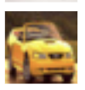
Feed-forward (FF) network for classification
For example, the CIFAR-10 dataset consists of 60000 32x32 color images in 10 classes (objects), with 6000 images per class. There are 50000 training images and 10000 test images. The task is to detect the object in the image. During training, we fit the weights to predict a large value for the correct class, and small values for all the rest.
y1
0
y2
5
y3
0
…
…
…
x1024
y10
0

Slide 61
What does the network learn?
If we focus on one neuron after training, we observe the following:
The number of weights the neuron has is 1024 (32x32).
We can re-arrange the weights as a two-dimensional array and visualize it as an image.
y1
0
y2
5
y3
0
…
…
…
x1024
y10
0

Slide 62
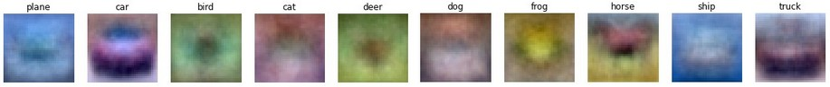
What does the network learn?
This is what we see for the first neuron:
y1
0
y2
5
y3
0
…
…
…
x1024
y10
0

Slide 63
What does the network learn?
If we do this for each neuron, we get:
y1
0
y2
5
y3
0
…
…
…
x1024
y10
0
The network learned the “average” picture for every object.

Slide 64
Back to our elephant problem
Each pixel may be considered as a feature.
We can now train a model to determine whether a new, unseen image contains an elephant. This would require a set of labeled images for training.

Slide 65
This is just the beginning…
There are many more topics to cover:
What if the best fitting curve is not a linear line? (non-linear models)
We can try building better models (smaller error) using even more layers, (deep learning)
We can improve gradient descent (and back prop) by introducing different techniques for controlling the learning speed.
How many examples do we need to train a good model?
We can start training a model with weights initialized by another model (transfer learning)
All of that will be covered in the course Machine Learning, stay tuned.

Slide 66
Machine Learning
Efi Arazi School of Computer Science
Introduction to Computer Science
Shimon Schocken
Lecture 12-1

